Slide 1


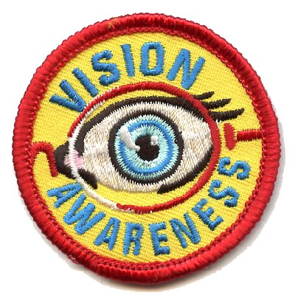

Vision Awareness Program
Girl Scouts & Boy Scouts

Slide 2
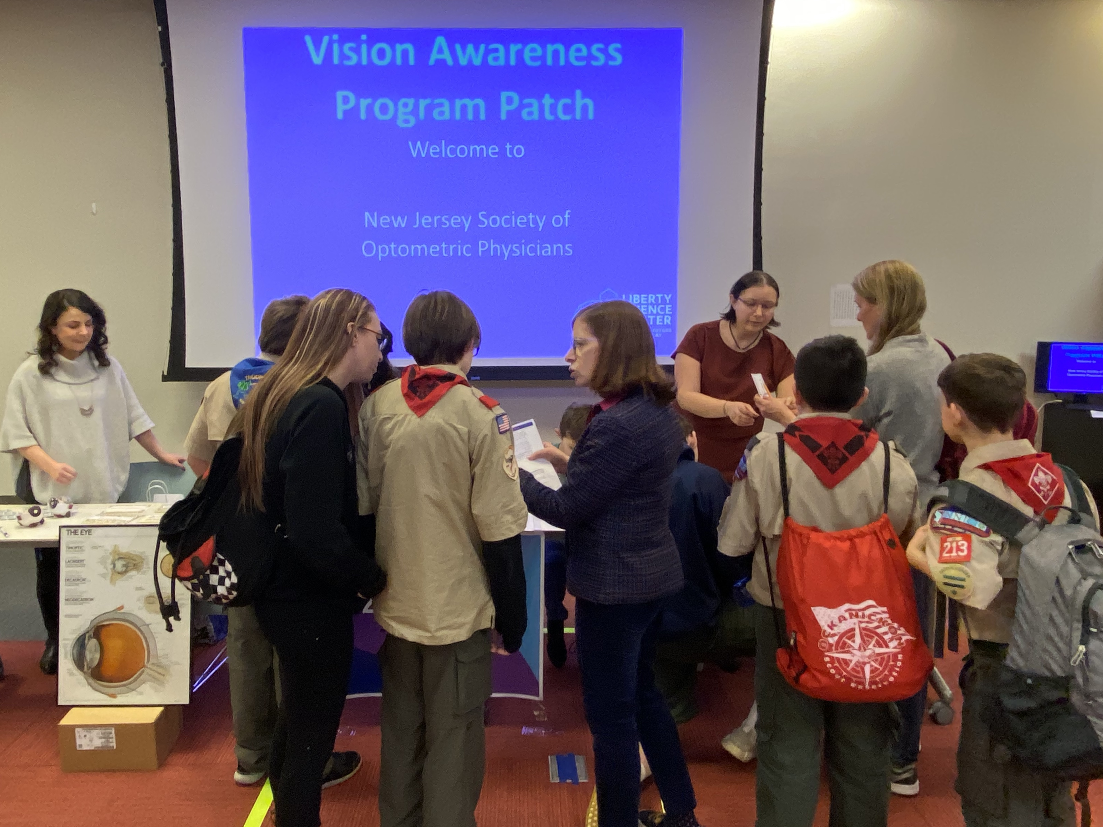
Vision Awareness Program
All levels of Scouts are eligible to participate in this program.
Earn a Scout Patch while learning about your eyes, vision & the importance of an eye exam.
Have a virtual visit to an eye doctor’s office and learn about 2 of the following suggested activities.

Slide 3
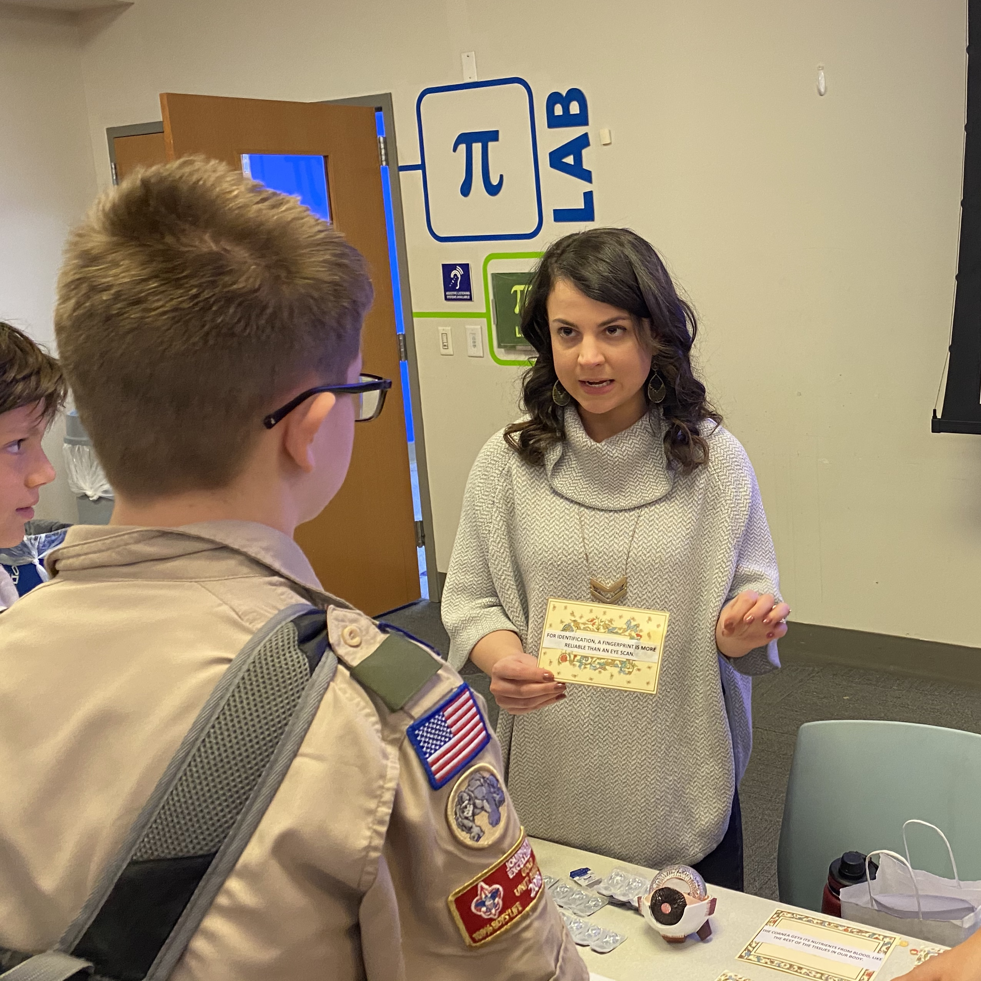
Vision Awareness Program Suggested Activities
1. Not everyone has 20/20 vision. Learn about nearsightedness, farsightedness, astigmatism and how contact lenses or glasses can help.

Slide 4
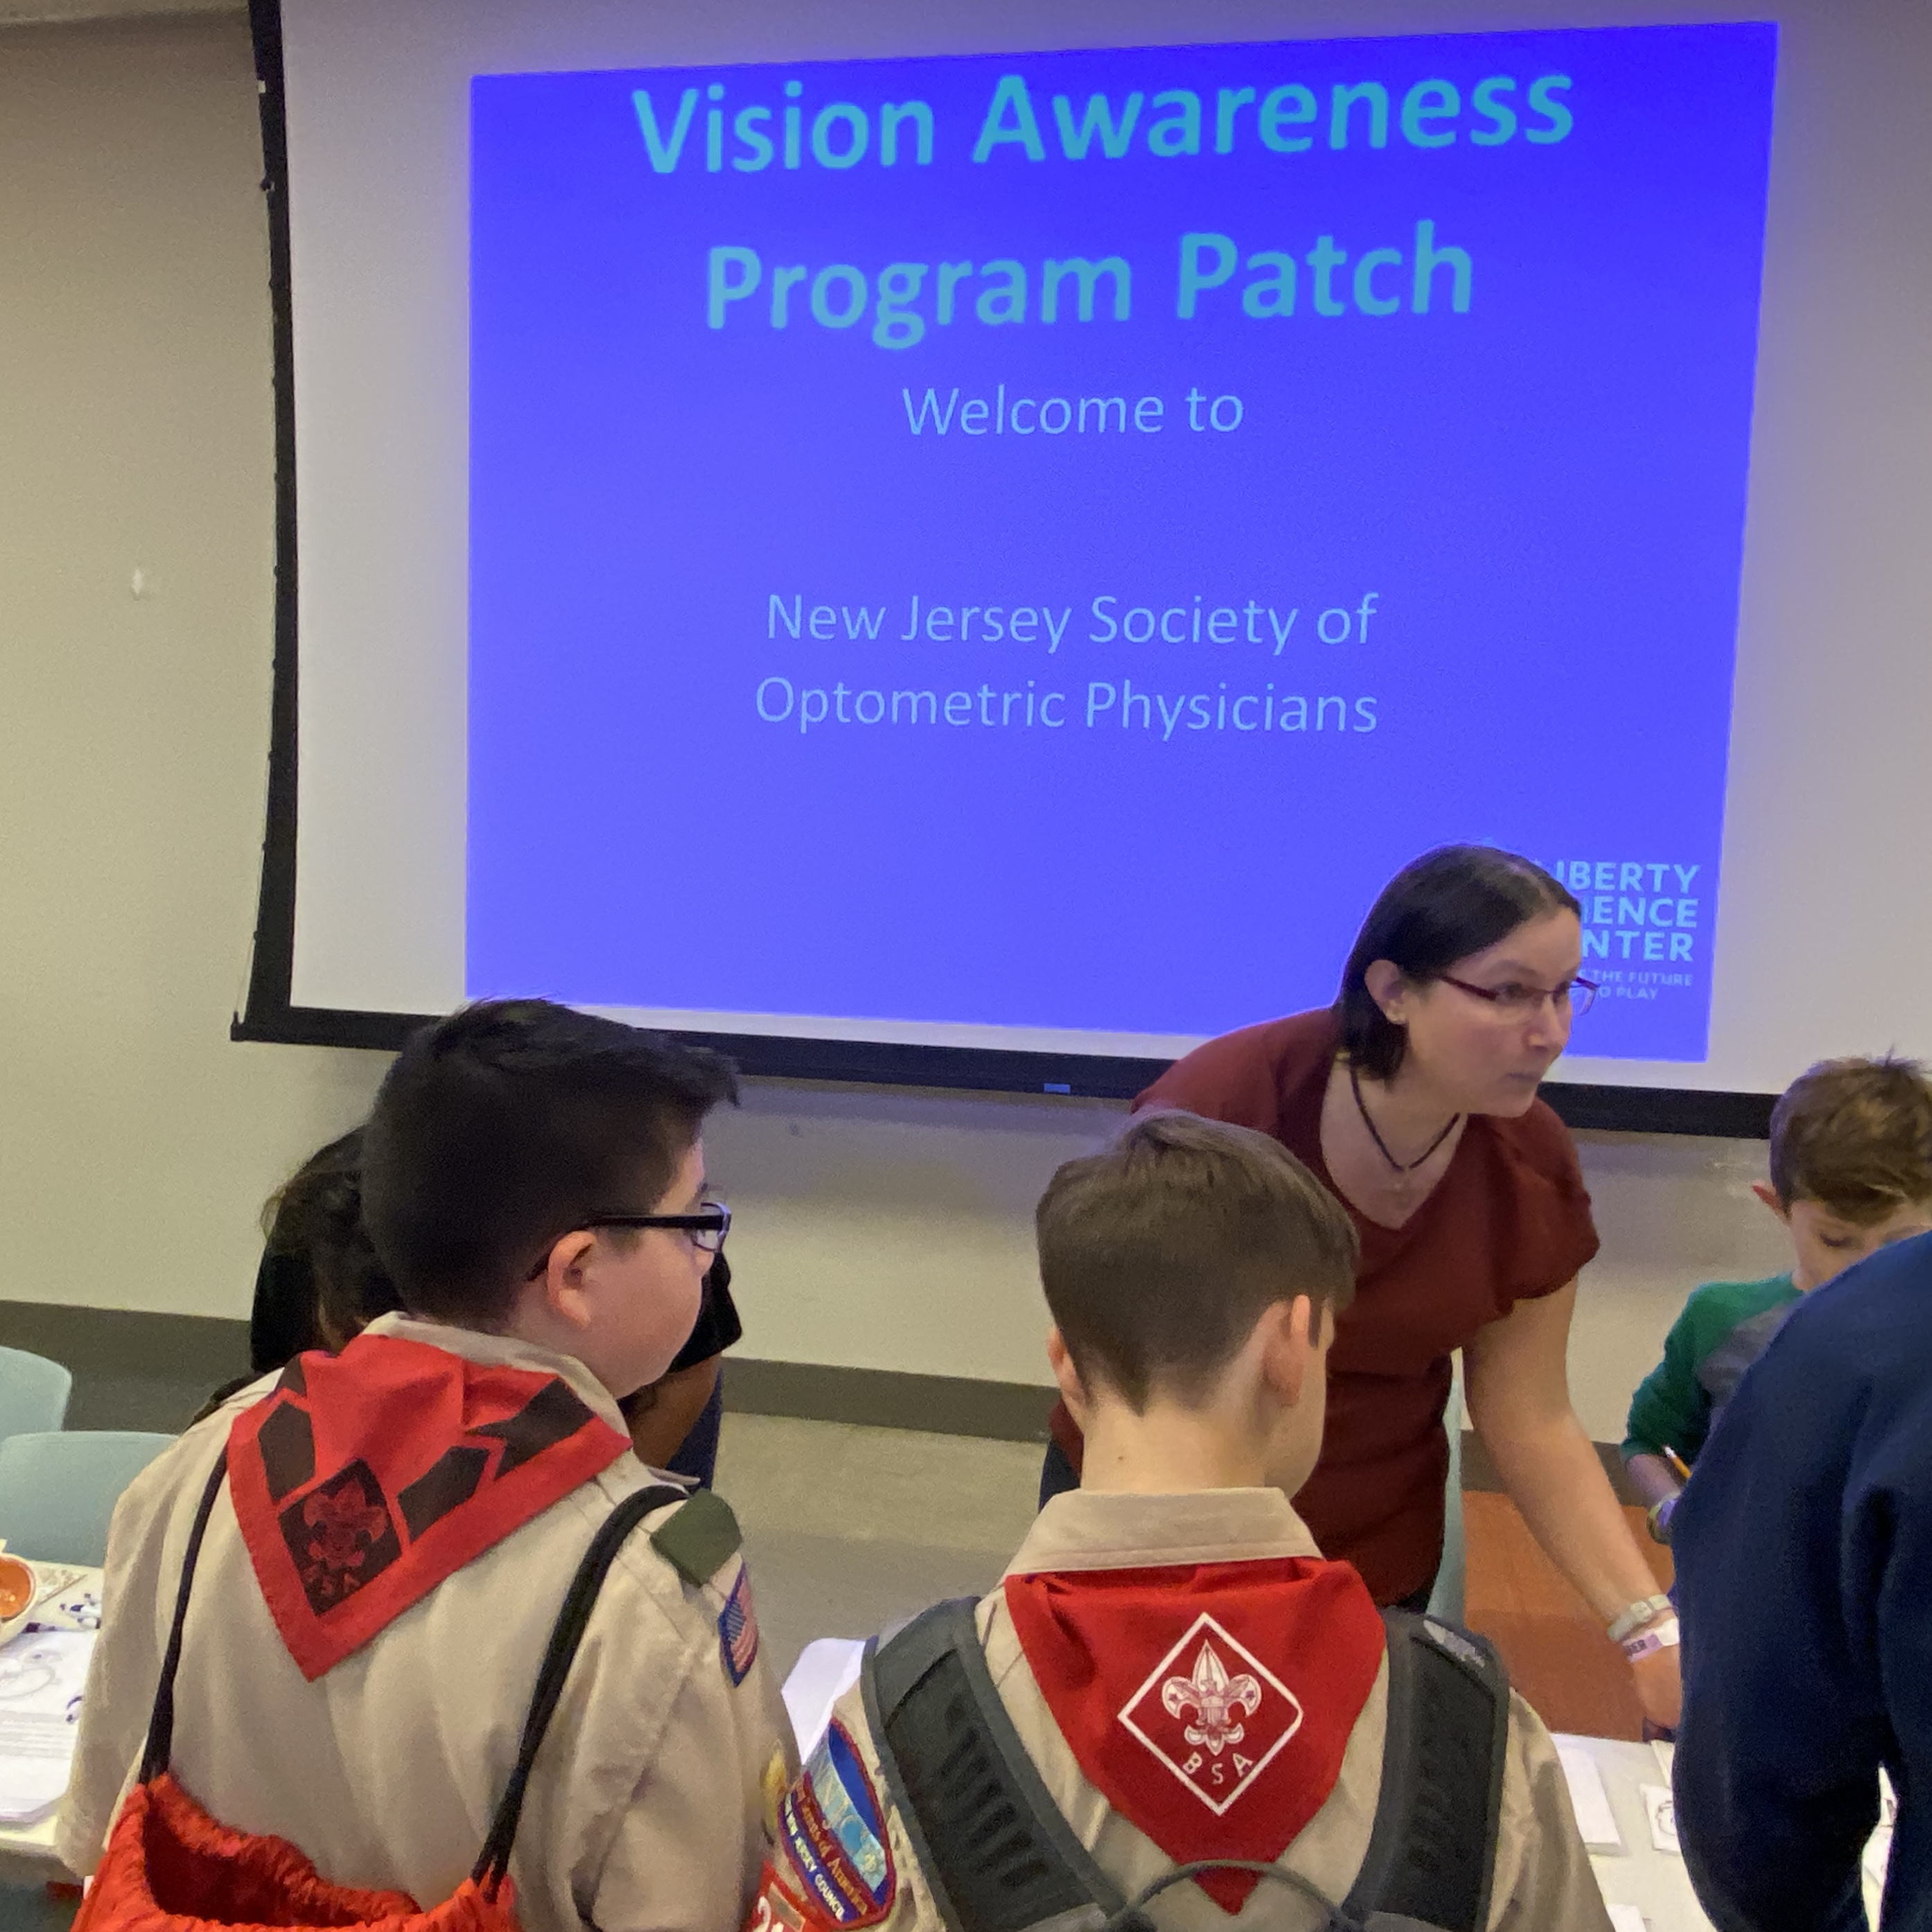
Vision Awareness Program Suggested Activities
2. Children often experience vision problems that are not easily detected. Learn how vision can affect school activities and how a Doctor of Optometry can help.

Slide 5
Vision Awareness Program Suggested Activities
3. National Save Your Vision Month is March. Make a poster in March or any time of the year that promotes eye health and good vision practices.

Slide 6
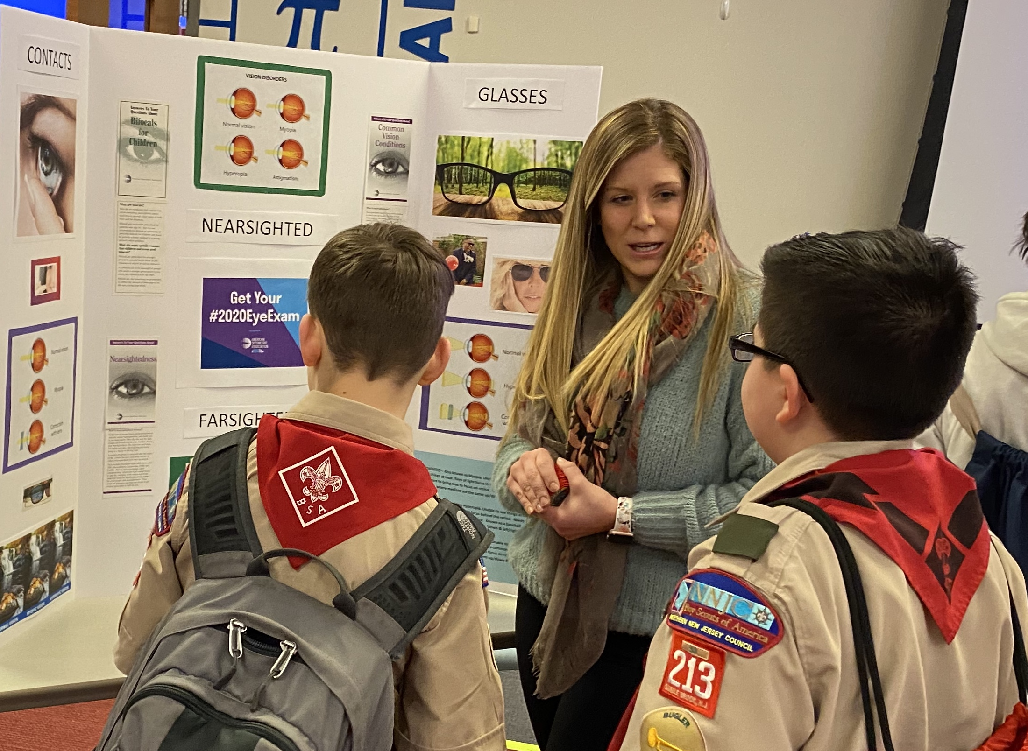
Vision Awareness Program Suggested Activities
4. Learn about a career as a Doctor of Optometry. What are Optometry School requirements? Where are Optometry Schools located?

Slide 7
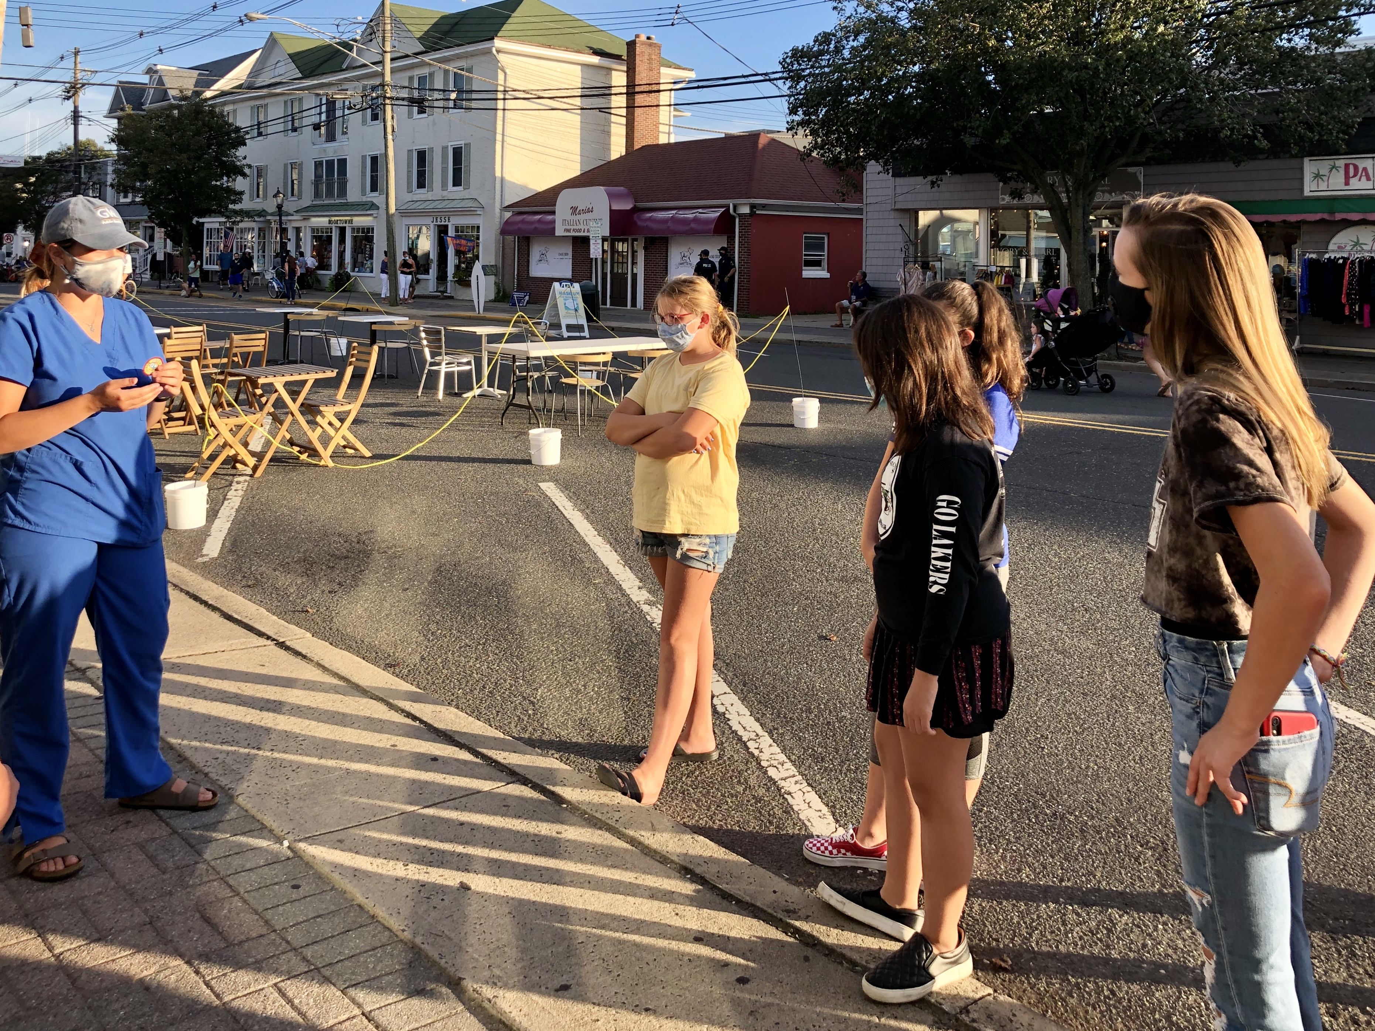
Vision Awareness Program Suggested Activities
5. Run an Eyeglass Donation Drive. Have your troop collect eyeglasses and contact a local service organization in your area that collects them.

Slide 8
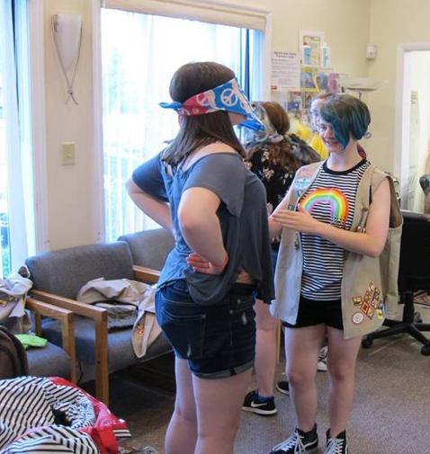
Vision Awareness Program Suggested Activities
6. Do “activities in the dark”. Divide the Scouts into pairs, having one scout be blindfolded and the other scout be non-blindfolded. The blindfolded scout should try some basic activities. The non-blindfolded scout should lead, explain what is seen and guide the scout for safety. Then trade roles.
How did it feel to not be able to see?

Slide 9
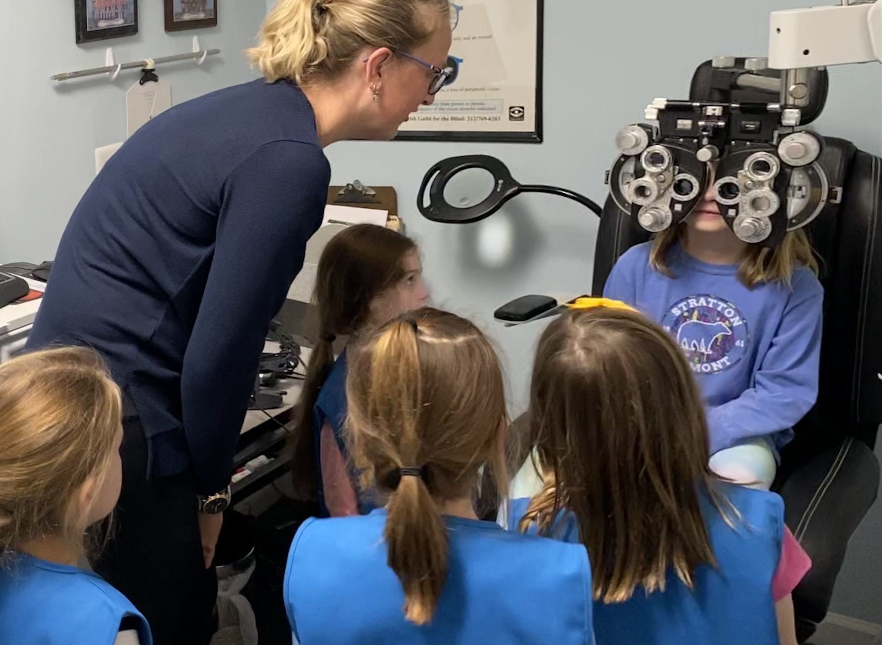
Common Vision Conditions
Nearsightedness (myopia) is when you can see at near but far away is blurry.
Farsightedness (hyperopia) is when you can see far away but up close is blurry.
Astigmatism is when objects at all distances are blurry.

Slide 10
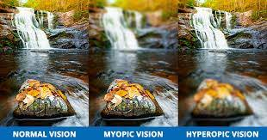
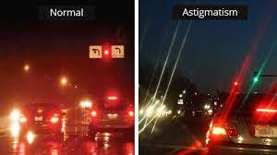
Myopia, Hyperopia, Astigmatism

Slide 11
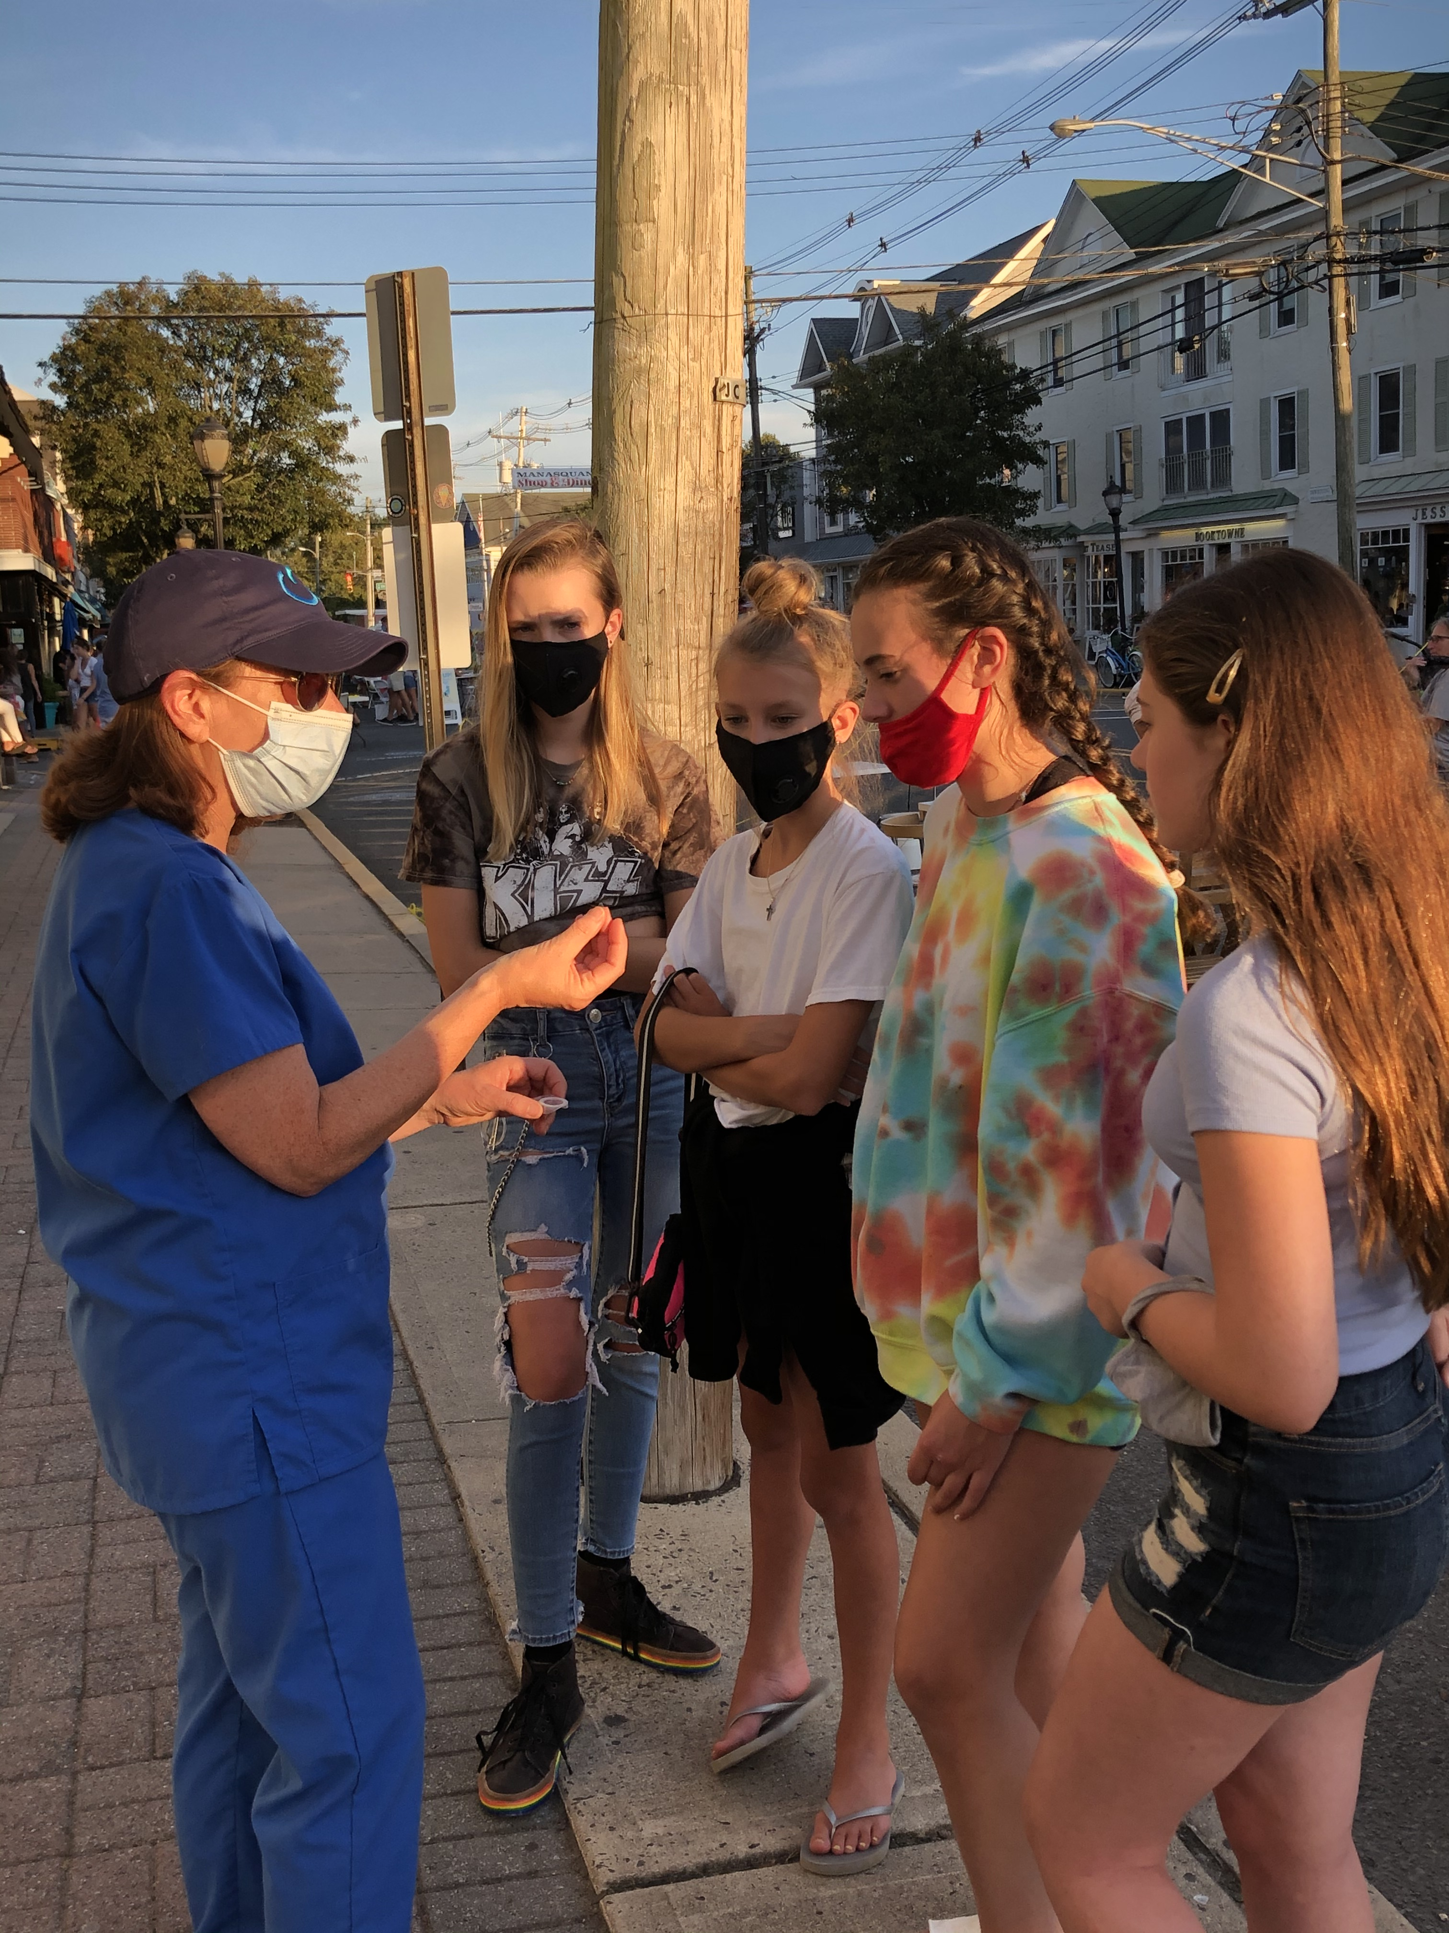
Glasses and Contacts
Glasses or Contact are primarily used to correct nearsightedness, farsightedness and astigmatism.
Some other types of glasses are sunglasses, rec specs, safety glasses, swimming goggles.
Some other types of Contacts are bandage contacts, tinted contacts, scleral contacts and specialty contacts.

Slide 12
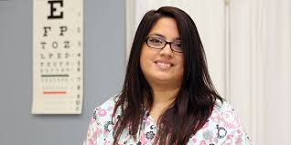

Glasses and Contacts

Slide 13
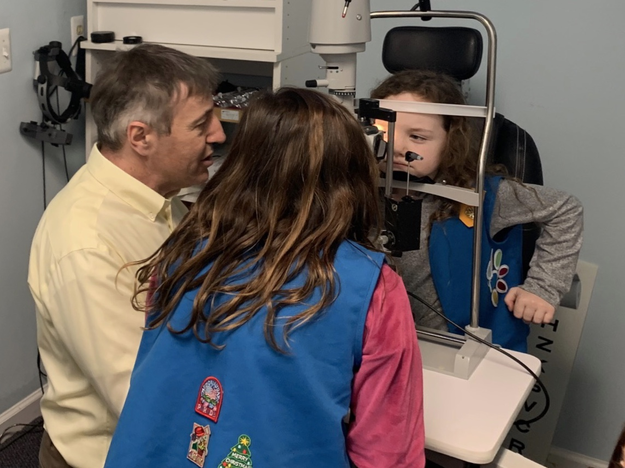
Ocular Health
Slit Lamp Exam
Cornea-clear window in front of the Iris and the Pupil.
Corneal Diseases can cause blurred vision.
Damage to the cornea may be due to genetic disorders or scarring from injuries and infections.
Lens-focusing system in the eye. It bends the light rays entering the eye in order to create a clear image on the retina.
Cataracts cause clouding of the lens and results on blurry vision.

Slide 14
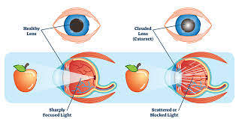
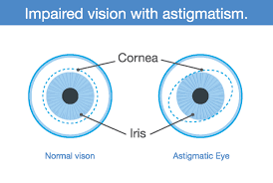
Cornea, Iris, Pupil, Cataracts, Astigmatism

Slide 15
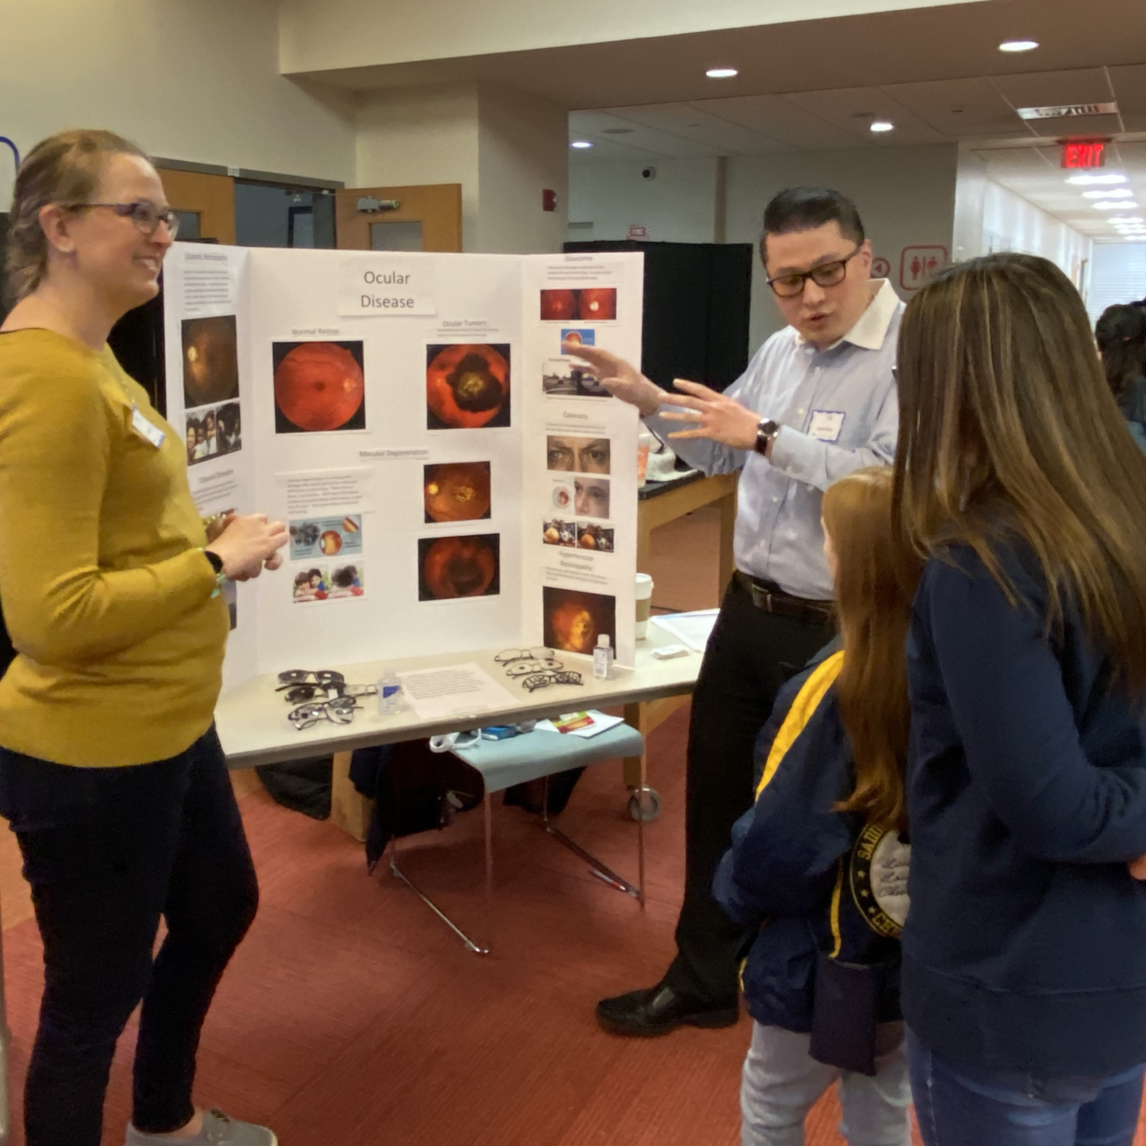
Ocular Health
Retinal Exam
Normal Retina consists of healthy blood vessels and healthy retinal cells.
Diabetic Retinopathy has damaged blood vessels that cause retinal swelling, retinal bleeding and loss of sight.
Macular Degeneration damages the cells in the central part of the retina. This is age related and also causes loss of sight.

Slide 16
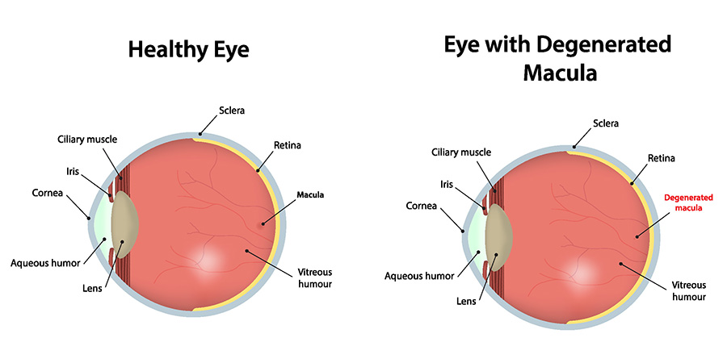

Slide 17
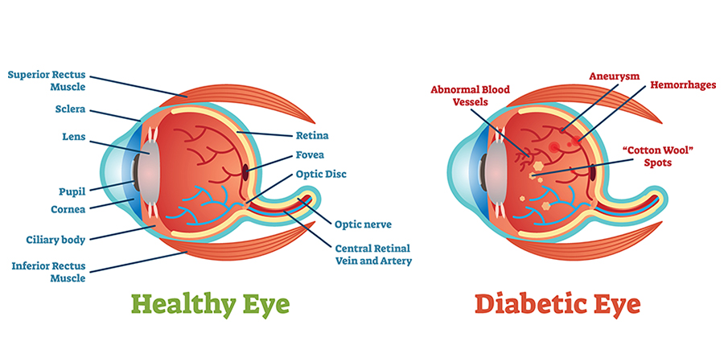

Slide 18
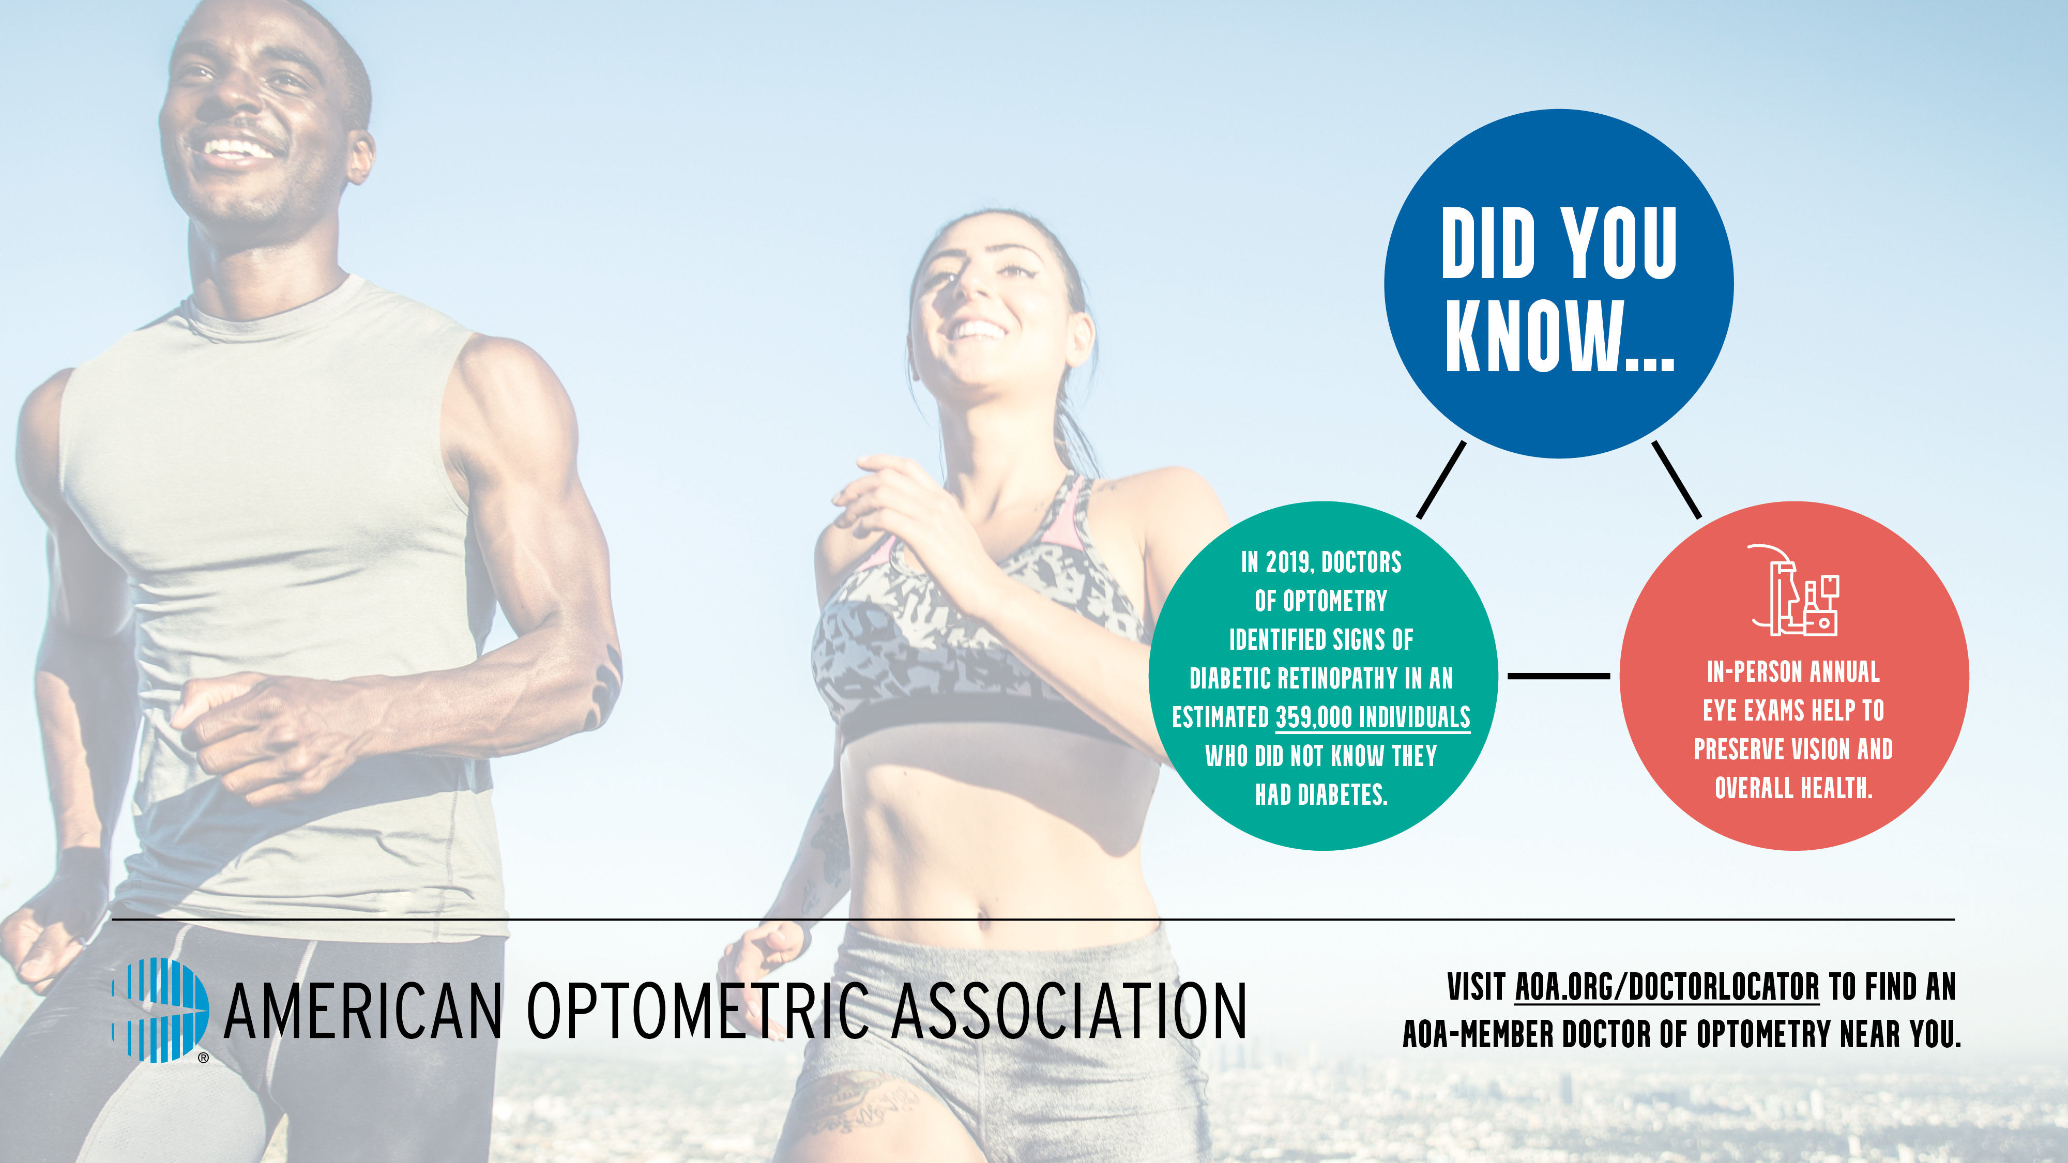

Slide 19
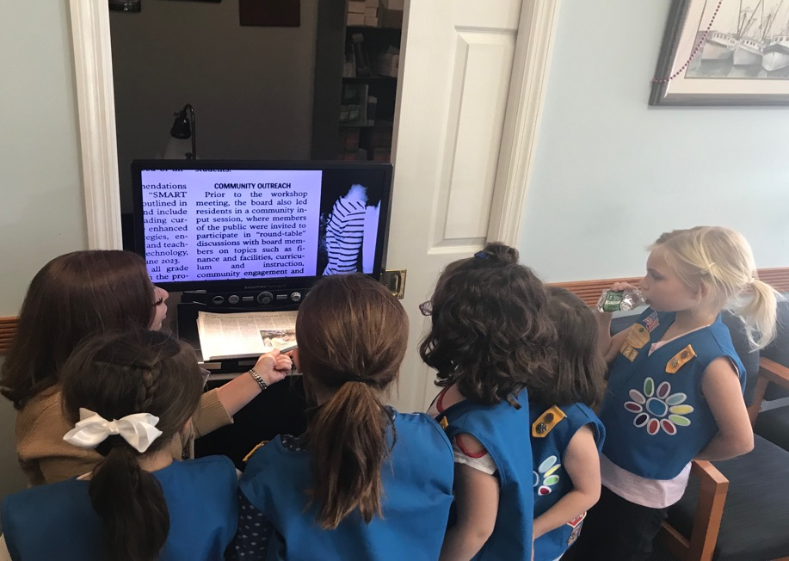
Low Vision Services
Some students are Visually Impaired or Legally Blind and use Low Vision Aids to help them see at school.
CCTV – is a Low Vision Aid that magnifies print that is placed on the table below the monitor. It enlarges the print on the screen so students who have difficulty seeing small print can enlarge it.
Other Low Vision Aids include Magnifiers, Telescopes and Microscopes.

Slide 20
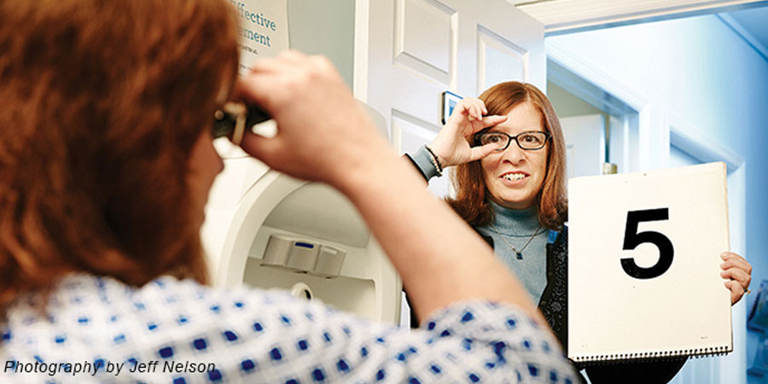

Slide 21


Congratulations in earning the
Vision
Awareness
Patch

Slide 22
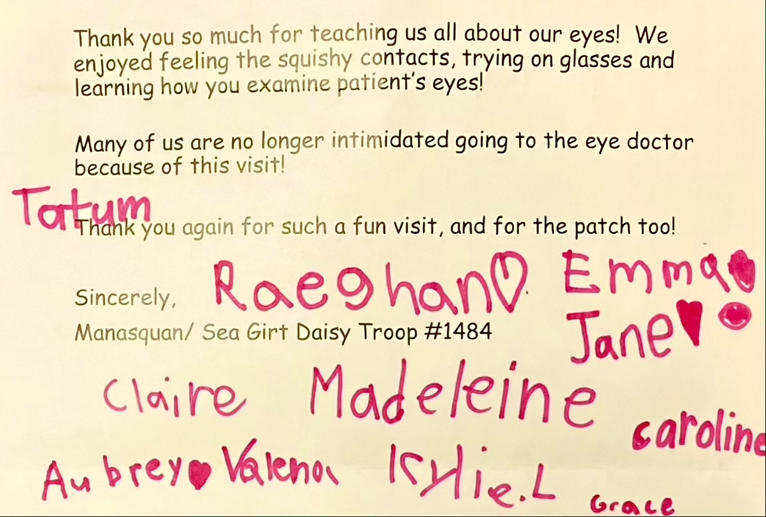
THANK
YOU

